Slide 1

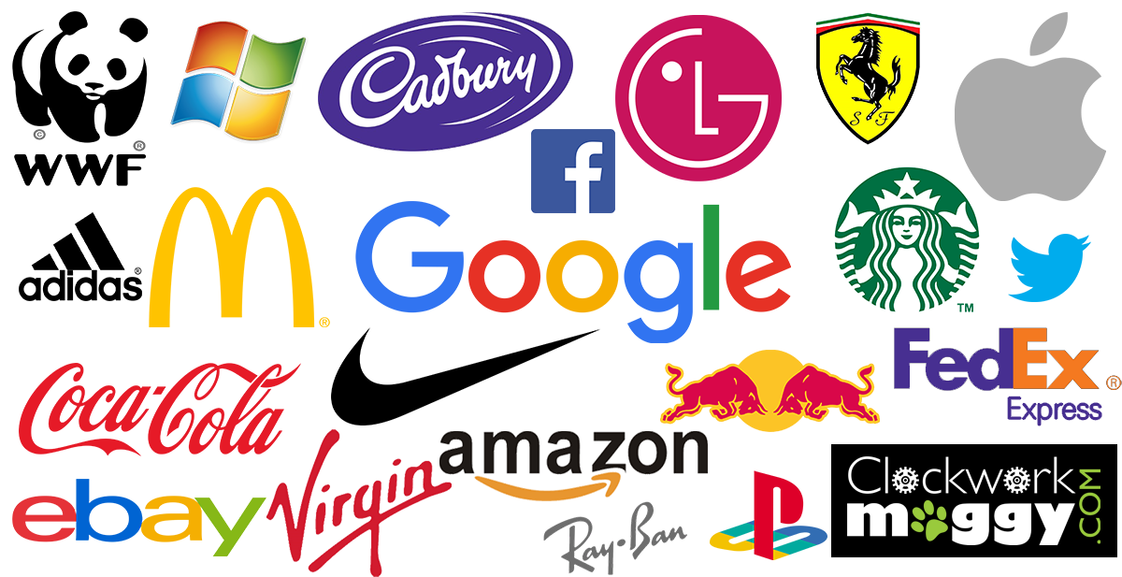

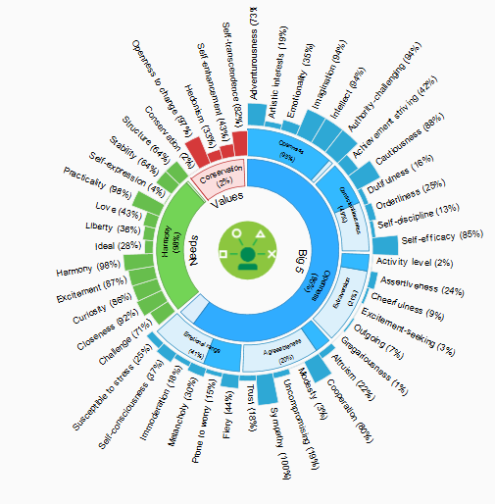


Your movement says more about you than you think
The Problem
Advertising segmentations are becoming less effective and overused. New solutions in-market are trying to leverage social media, but only a limited population post information on social media and is not a representation of the larger population.
The Hypothesis
By leveraging location/movement data, we can understand a customers journey, their visitation to Points of Interest (POIs) and frequency to derive more accurate personas, brand affinities, and shift in lifestyle changes. This can then be stratified to a larger audience/universe for scale based on similar demographics and activity.
What Are We Solving?
Who should I target?
Who else might be valuable?
What can we learn about them?
When should we reach out to them?
The Approach
Start with raw location data
+
Add points of interest (Brands) to location data
+
Capture Twitter post from followers of Brands and also Brand posts
+
Run Personality Insights by IBM
+
Weight values based on visitation rates
=
Persona of user based on needs and values

